Slide 1
Data Science 6600 the application of targeted maximum likelihood estimation to the estimation of causal effects
Professor: Dr.Alysha Cooper
STUDENT:Mohsen Selseleh
Summer 2022

Slide 2
Definition of Causation
A treatment has an average effect on the outcome for individuals i if their potential outcomes are not equal for a dichotomous treatment.
Counterfactual framework provides a basis for defining effects such as difference in mean outcomes between treatment and control groups.

Slide 3
Assumption of causal inference
We can treat an observational study as a conditionally randomized experiment if the following assumptions are met:
Consistency:The consistency assumption implies that an individual's potential outcome under his or her observed exposure history is the outcome that will actually be observed for that person
Exchangeability(no unmeasured confounding)
Posivtity:Positivity is the assumption that any individual has a positive probability of receiving all values of the treatment variable: Pr(A=a) > 0 for all values of a. In other words, you need to have both people who smoke, and people who don't smoke.

Slide 4
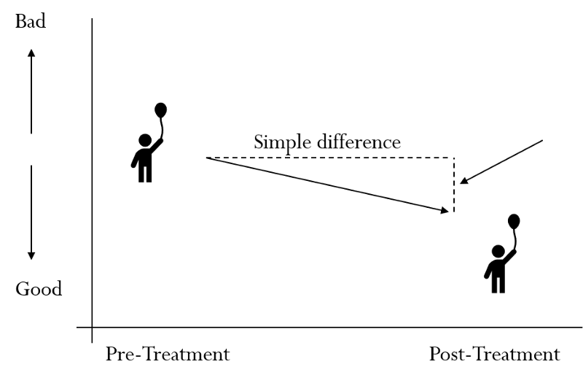

Slide 5
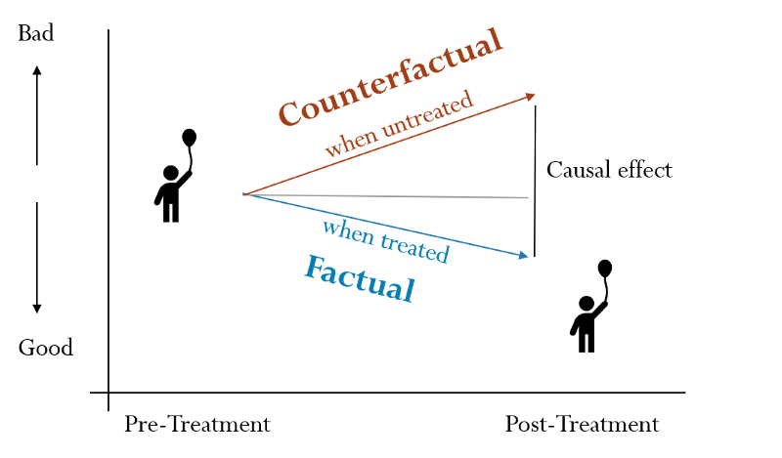
Impact = factual — counterfactual

Slide 6
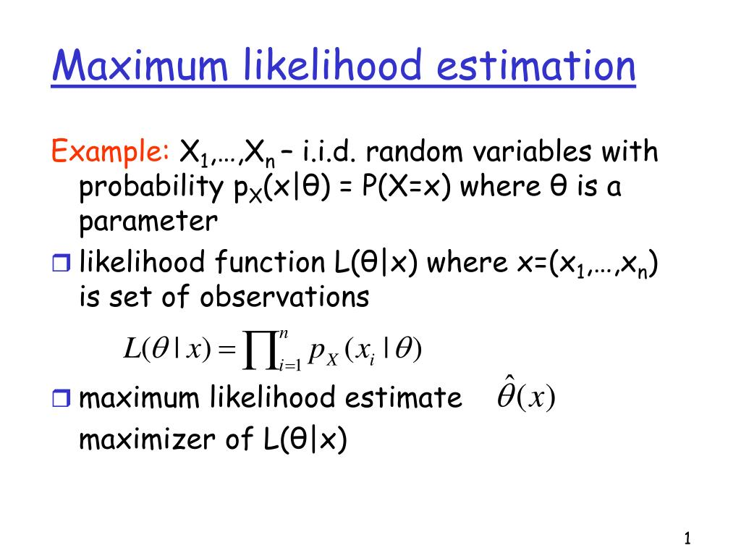

Slide 7
Maximum likelihood estimation fits a model to data, minimizing a global measure, such as mean squared error (MSE). TMLE targets the MLE estimate of the parameter of interest in a way that reduces bias but increase variance of estimates(trade-off)
TMLE is related to G-computation and propensity score methods in that TMLE involves estimation of both
E (Y | A, X ) ; relies on estimation of the outcome mechanism—namely the conditional expectation of the outcome given the exposure and covariates, denoted(similar to G-computation)
and P (A= 1| X).; estimation of the exposure mechanism—namely the conditional probability of being exposed given the observed confounders X, denoted(similar to propensity score method)

Slide 8
While many applications of causal effect estimation use propensity score methods or G-computation, targeted maximum likelihood estimation(TMLE) is a well-established alternative method . TMLE is a doubly robust maximum-likelihood-based approach that includes a secondary targeting step that optimizes the bias-variance tradeoff for the target parameter.
G-computation calculate ATE as mean difference in predicted outcome pairs across individulas
Inverse probability weighting calculate ATE as mean difference between weithted outcomes among exposed and unexposed
TMLE calculate ATE as mean difference in targeted outcome pairs across individuals

Slide 9
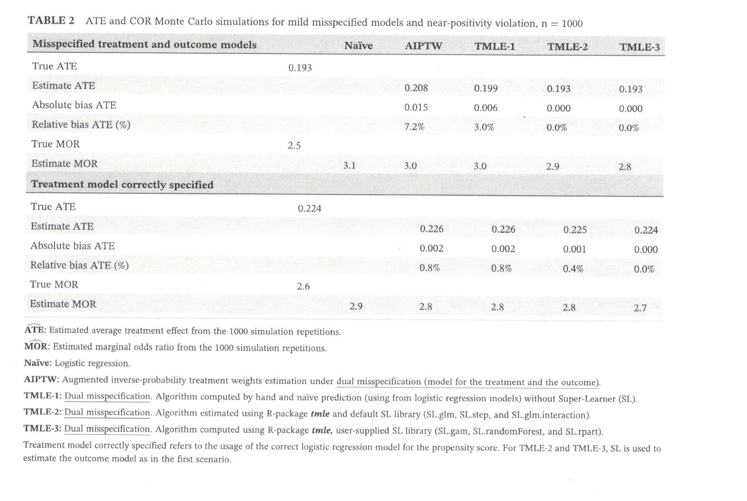

Slide 10
When estimating the average effect of a binary treatment(or exposure) on an outcome, methods propensity scores, G-formula or targeted maximum likelihood estimation(TMLE) are preferred over naïve regression ,which biased under misspecification of a parametric model. In contrast propensity socre methods require the correct specification of an exposure model. Double-robust methods require the correct specification of an exposure model.it improves the chance of correct model specification by allowing for flexible estimation using machine learning methods.therefore it needs weaker assumptions.

Slide 11
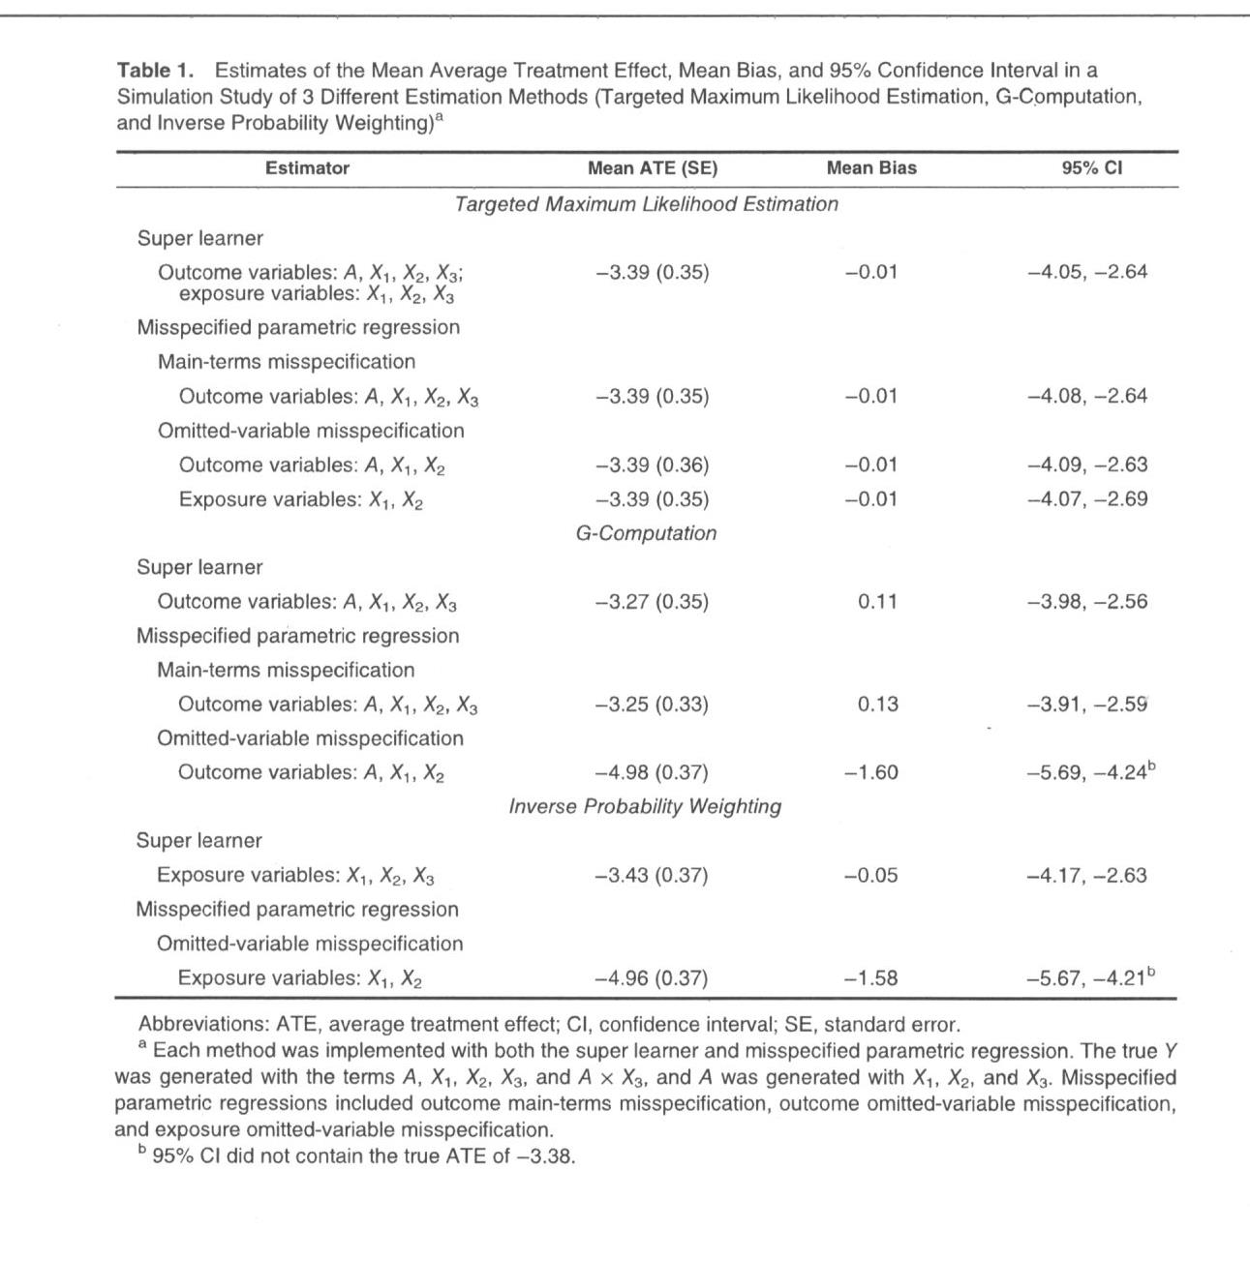

Slide 12
References
Gruber, S., & Van Der Laan, M. J. (2009). Targeted maximum likelihood estimation: A gentle introduction.
Luque‐Fernandez, M. A., Schomaker, M., Rachet, B., & Schnitzer, M. E. (2018). Targeted maximum likelihood estimation for a binary treatment: A tutorial. Statistics in medicine, 37(16), 2530-2546.
Schuler, M. S., & Rose, S. (2017). Targeted maximum likelihood estimation for causal inference in observational studies. American journal of epidemiology, 185(1), 65-73.

